Slide 1



Spring Security - Custom Login Form
m

Slide 2
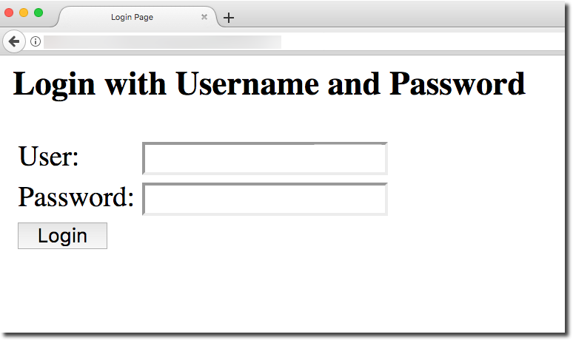

Spring Security - Default Login Form
Good for quick start
www.luv2code.com

Slide 3
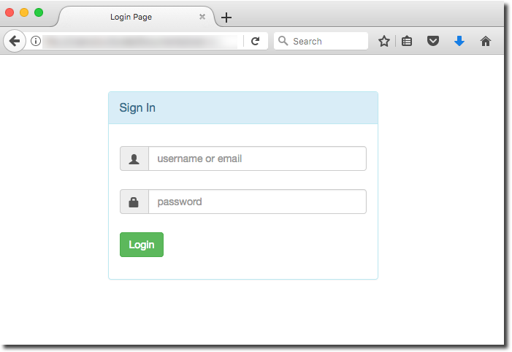

Your Own Custom Login Form
Your own custom look-and-feel HTML + CSS
www.luv2code.com

Slide 4






Spring Security Overview
/mytopsecretstuff
Protected Web Resource
Spring Security Filters
Web Browser
my app security configuration
users passwords roles
www.luv2code.com

Slide 5
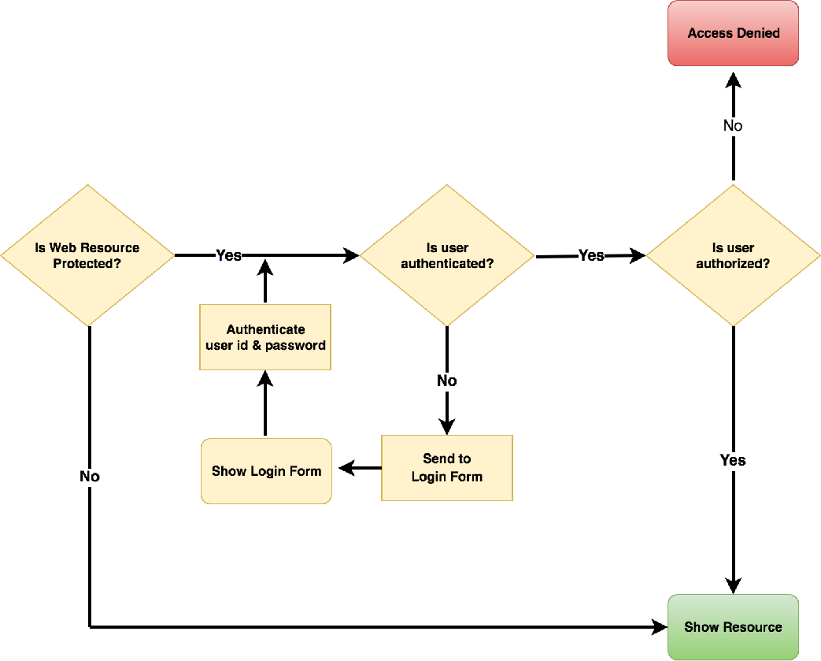


Spring Security in Action
Spring Security Filters
Our custom login form
www.luv2code.com

Slide 6
Development Process
Step-By-Step
Modify Spring Security Configuration to reference custom login form
Develop a Controller to show the custom login form
Create custom login form
✤
HTML (CSS optional)
✤
Spring MVC form tag <form:form>
www.luv2code.com

Slide 7

Step 1: Modify Spring Security Configuration
File: DemoSecurityConfig.java
@Configuration @EnableWebSecurity
public class DemoSecurityConfig extends WebSecurityConfigurerAdapter {
// override method to configure users for in-memory authentication …
}
Method | Description
configure(AuthenticationManagerBuilder) | Configure users (in memory, database, ldap, etc)
configure(HttpSecurity) | Configure security of web paths in application, login, logout etc
www.luv2code.com

Slide 8



Step 1: Modify Spring Security Configuration
File: DemoSecurityConfig.java
@Configuration @EnableWebSecurity
public class DemoSecurityConfig extends WebSecurityConfigurerAdapter {
@Override
protected void configure(AuthenticationManagerBuilder auth) throws Exception {
// add our users for in memory authentication
…
}
@Override
protected void configure(HttpSecurity http) throws Exception {
Configure security of web paths in application, login, logout etc
http.authorizeRequests()
.anyRequest().authenticated()
.and()
.formLogin()
.loginPage("/showMyLoginPage")
.loginProcessingUrl("/authenticateTheUser")
.permitAll();
}
}
www.luv2code.com

Slide 9



Step 1: Modify Spring Security Configuration
@Override
protected void configure(HttpSecurity http) throws Exception {
http.authorizeRequests()
.anyRequest().authenticated()
.and()
.formLogin()
.loginPage("/showMyLoginPage")
Restrict access based on the HttpServletRequest
.loginProcessingUrl("/authenticateTheUser")
.permitAll();
}
www.luv2code.com

Slide 10


Step 1: Modify Spring Security Configuration
@Override
protected void configure(HttpSecurity http) throws Exception {
http.authorizeRequests()
.anyRequest().authenticated()
.and()
.formLogin()
.loginPage("/showMyLoginPage")
Any request to the app must be authenticated (ie logged in)
.loginProcessingUrl("/authenticateTheUser")
.permitAll();
}
www.luv2code.com

Slide 11


Step 1: Modify Spring Security Configuration
@Override
protected void configure(HttpSecurity http) throws Exception {
http.authorizeRequests()
We are customizing the form
.anyRequest().authenticated()
login process
.and()
.formLogin()
.loginPage("/showMyLoginPage")
.loginProcessingUrl("/authenticateTheUser")
.permitAll();
}
www.luv2code.com

Slide 12


Step 1: Modify Spring Security Configuration
@Override
protected void configure(HttpSecurity http_{S})_{ho}t_{w}hr_{o}o_{u}w_{r}s_{cu}E_{s}x_{t}c_{o}e_{m}pt_{fo}i_{r}o_{m}n _{a}{_{t the}
request mapping
http.authorizeRequests()
.anyRequest().authenticated()
.and()
.formLogin()
.loginPage("/showMyLoginPage")
“/showMyLoginPage”
.loginProcessingUrl("/authenticateTheUser")
.permitAll();
}
www.luv2code.com

Slide 13


Step 1: Modify Spring Security Configuration
@Override
protected void configure(HttpSecurity httpL)ogtihnrfoowrsm EshxcoeupldtPioOnST{data to
this URL for processing
http.authorizeRequests()
.anyRequest().authenticated()
.and()
.formLogin()
.loginPage("/showMyLoginPage")
(check user id and password)
.loginProcessingUrl("/authenticateTheUser")
.permitAll();
}
www.luv2code.com

Slide 14


Step 1: Modify Spring Security Configuration
@Override
protected void configure(HttpSecurity htt_{Y}p_{o})_{u c}t_{a}h_{n}r_{g}o_{i}w_{v}s_{e A}E_{N}xc_{Y}e_{v}p_{a}t_{lu}i_{e}o_{s}n {
for this configuration.
http.authorizeRequests()
.anyRequest().authenticated() Just stay consistent in your app
.and()
.formLogin()
.loginPage("/showMyLoginPage")
.loginProcessingUrl("/authenticateTheUser")
.permitAll();
}
www.luv2code.com

Slide 15

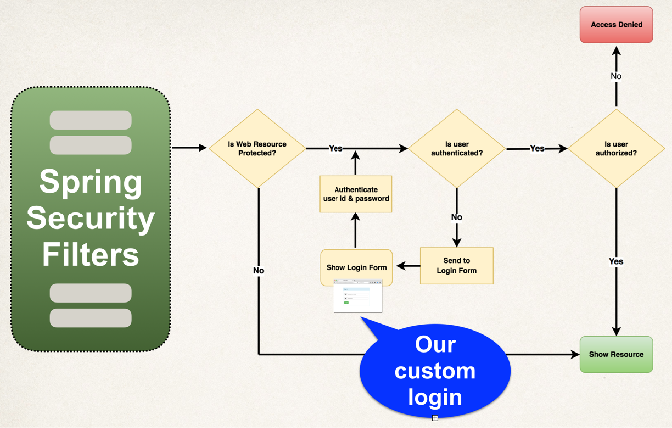


Step 1: Modify Spring Security Configuration
@Override
protected void configure(HttpSecurity http) throws Exception {
http.authorizeRequests()
.anyRequest().authenticated()
.and()
.formLogin()
.loginPage("/showMyLoginPage")
.loginProcessingUrl("/authenticateTheUser")
.permitAll();
}
Allow everyone to see login page.
No need to be logged in.
www.luv2code.com
www.luv2code.com

Slide 16




Step 1: Modify Spring Security Configuration
TO DO
@Override
We need to create a controller
protected void configure(HttpSecurity http)_{for}th_{th}r_{i}o_{s}w_{r}s_{eq}E_{u}x_{es}c_{t}e_{m}pt_{a}i_{p}o_{p}n_{ing}{
http.authorizeRequests()
“/showMyLoginPage”
.anyRequest().authenticated()
.and()
.formLogin()
.loginPage("/showMyLoginPage")
.loginProcessingUrl("/authenticateTheUser")
.permitAll();
}
No Controller Request Mapping required for this.
We get this for free :-)
www.luv2code.com

Slide 17
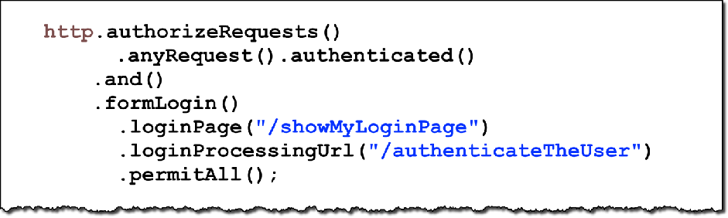



Step 2: Develop a Controller to show the custom login form
File: LoginController.java
@Controller
public class LoginController {
@GetMapping("/showMyLoginPage") public String showMyLoginPage() {
return "plain-login";
}
View name
}
/WEB-INF/view/plain-login.jsp
www.luv2code.com

Slide 18


Step 2: Develop a Controller to show the custom login form
File: LoginController.java
@Controller
public class LoginController {
@GetMapping("/showMyLoginPage") public String showMyLoginPage() {
return "plain-login";
}
}
/WEB-INF/view/plain-login.jsp
www.luv2code.com

Slide 19

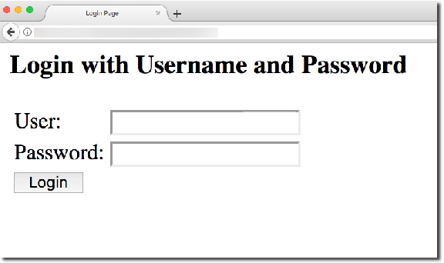

Step 3: Create custom login form
Send data to login processing URL: /authenticateTheUser
/authenticateTheUser
Spring Security Filters
www.luv2code.com

Slide 20


Step 3: Create custom login form
Send data to login processing URL: /authenticateTheUser
/authenticateTheUser
Spring Security Filters
You can give ANY values for this configuration.
Just stay consistent in your app
www.luv2code.com

Slide 21

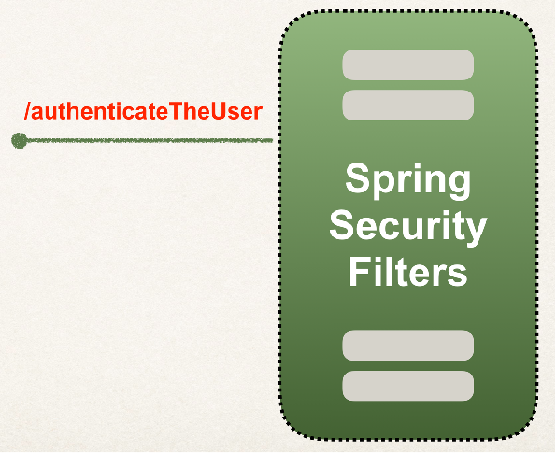

Step 3: Create custom login form
Send data to login processing URL: /authenticateTheUser
•
Login processing URL will be handled by Spring Security Filters
•
You get it for free … no coding required
This is
Spring Security magic … LOL
www.luv2code.com

Slide 22


Step 3: Create custom login form
Send data to login processing URL: /authenticateTheUser
Must POST the data
<form:form action="${pageContext.request.contextPath}/authenticateTheUser" method="POST">
…
</form:form>
www.luv2code.com

Slide 23

Step 3: Create custom login form
Best Practice
•
Best practice is to use the Spring MVC Form tag <form:form>
•
Provides automatic support for security defenses (more on this later)
<form:form action="…" method="…" >
…
</form:form>
www.luv2code.com

Slide 24


Step 3: Create custom login form
•
Spring Security defines default names for login form fields
User name field: username
Password field: password
Spring Security Filters will read the form data and
authenticate the user
User name: <input type="text" name="username" />
Password: <input type="password" name="password" />
www.luv2code.com

Slide 25


Step 3: Create custom login form
Pull It All
Together
File: WEB-INF/view/plain-login.jsp
<%@ taglib prefix="form" uri="http://www.springframework.org/tags/form" %>
…
<form:form action="${pageContext.request.contextPath}/authenticateTheUser" method="POST">
<p>
User name: <input type="text" name="username" />
</p>
<p>
Password: <input type="password" name="password" />
</p>
<input type="submit" value="Login" />
</form:form>
…
www.luv2code.com

Slide 26

Step 3: Create custom login form
Pull It All
Together
File: WEB-INF/view/plain-login.jsp
<%@ taglib prefix="form" uri="http://www.springframework.org/tags/form" %>
…
<form:form action="${pageContext.request.contextPath}/authenticateTheUser" method="POST">
<p>
User name: <input type="text" name="username" />
</p>
<p>
Password: <input type="password" name="password" />
</p>
<input type="submit" value="Login" />
</form:form>
…
www.luv2code.com

Slide 27
Spring Security in Action
Spring Security Filters
www.luv2code.com

Slide 28

More Info on Context Path
What is this???
<form:form action="${pageContext.request.contextPath}/authenticateTheUser" method="POST">
…
</form:form>
www.luv2code.com

Slide 29


More Info on Context Path
Context Path
is same thing as
Context Root
www.luv2code.com

Slide 30

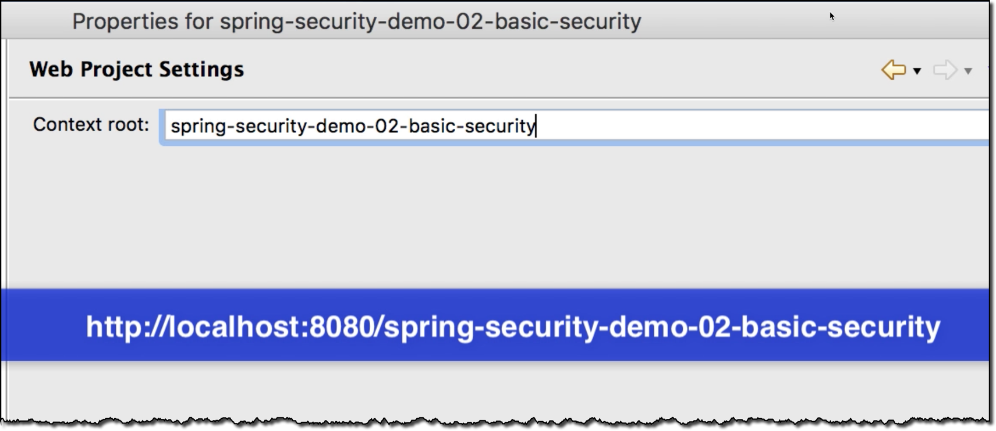
More Info on Context Path
Context Path
is same thing as
Context Root
www.luv2code.com

Slide 31

More Info on Context Path
Gives us access to context path dynamically
<form:form action="${pageContext.request.contextPath}/authenticateTheUser" method="POST">
…
</form:form>
www.luv2code.com

Slide 32
Why use Context Path?
Best Practice
Allows us to dynamically reference context path of application
•
Helps to keep links relative to application context path
•
If you change context path of app, then links will still work
•
Much better than hard-coding context path …
www.luv2code.com

